Slide 1


Smart India Hackathon 2020
Indian Institute of Information Technology, Nagpur
Software Edition
Problem Statement: Marksheet Generator
Team name: Double Trident

Slide 2

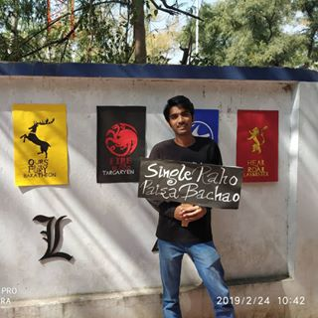
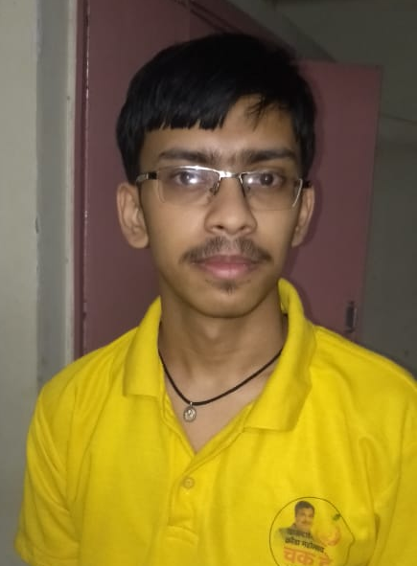
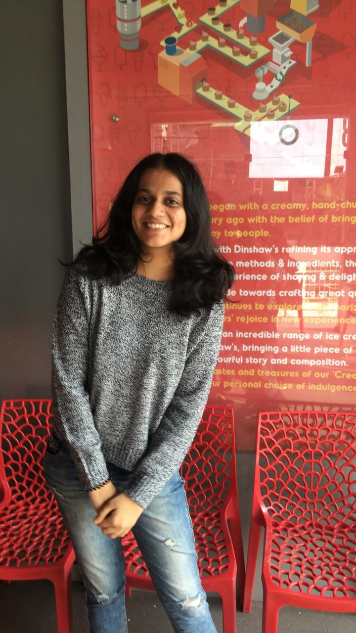
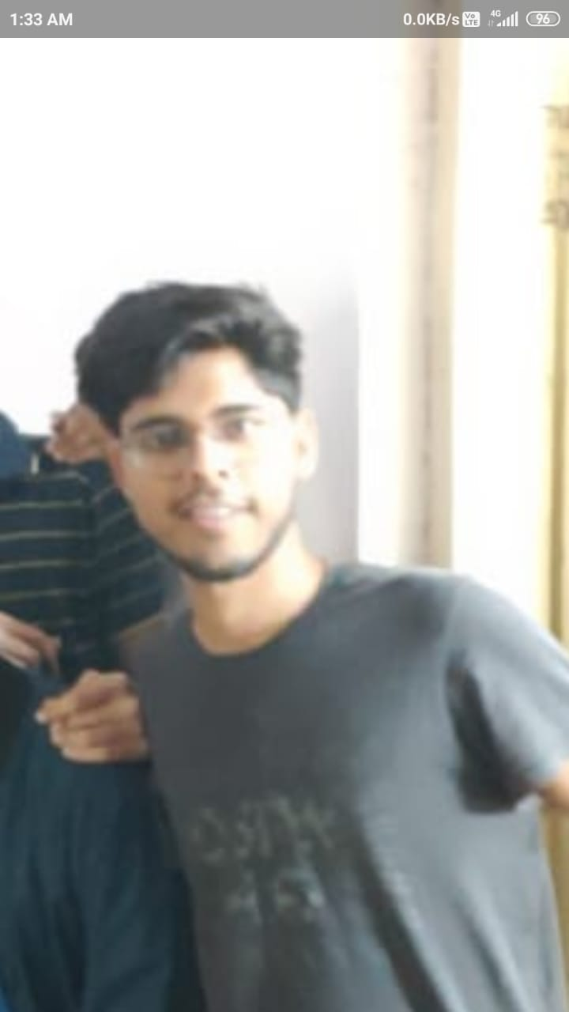

Sarthak Shukla
Apurv Chandel
Shubham Sagar
Nandita Mendhe
Raj Singh Yadav
Mranal Shroff

